Slide 1
ELEVATOR PROJECT
Kyle, Ben, Max

Slide 2
Summary
Key Capabilities
Strategy
Design Pattern
UML
Challenges (code walkthrough)
Demonstration

Slide 3
Key Capabilities
Able to process user inputs
Run multiple elevators at once via threading
Optimise the elevators chosen for each command
Draw the elevator states to a graphical interface

Slide 4
Our Strategy
Input
Scheduler
Loop elevators list
ELEVATOR IDLE?
ELEVATOR GOING UP?
INPUT GOING UP AND ALONG THE WAY?
ELEVATOR GOING DOWN?
INPUT GOING DOWN AND ALONG THE WAY?

Slide 5
Design Patterns
Model View Controller (MVC)
Facade
Notes:
MVC - Controller Elevator FrameView
Facade - GenCommands and UserInput only ever talk to Scheduler, which does the heavy lifting for the rest of the program

Slide 6
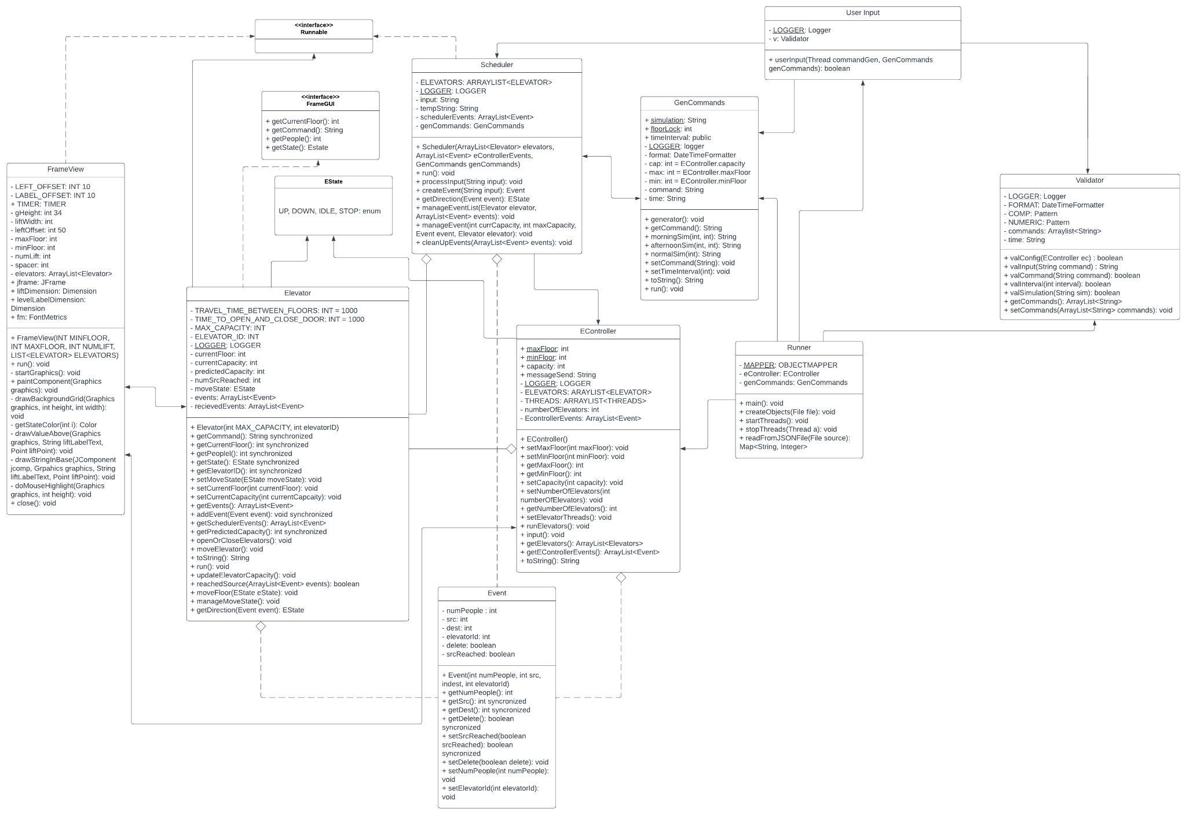
UML

Slide 7
Challenges
User Input and Validation
Ensuring that user input met various requirements
Handling incorrect commands, while keeping correct ones
Elevators
Threading
Generating commands
Choosing the best elevator
Linking everything together

Slide 8
Thank you

